Slide 1
What is Kinematics

Slide 2
Kinematics studies the motion of bodies

Slide 3
Joints for Robots

Slide 4
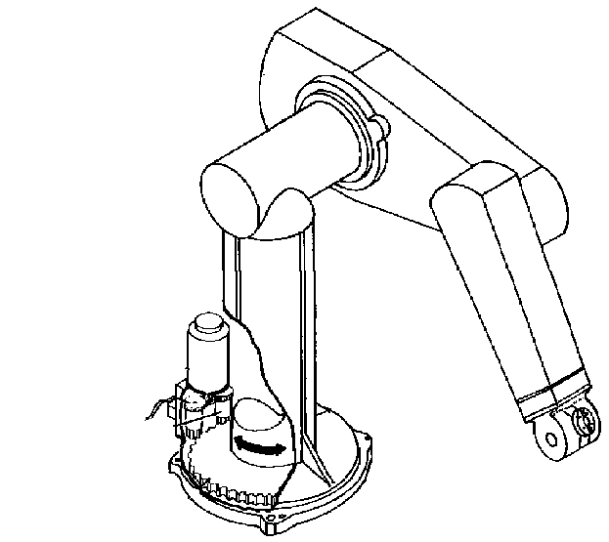
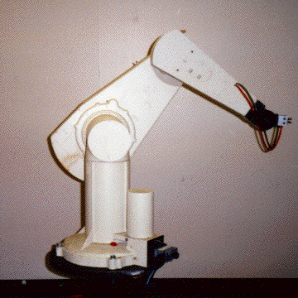
An Example - The PUMA 560
2
3
4
1
There are two more joints on the end effector (the gripper)
The PUMA 560 has SIX revolute joints
A revolute joint has ONE degree of freedom ( 1 DOF) that is defined by its angle
Concepts:
Revolute joint
DOF

Slide 5
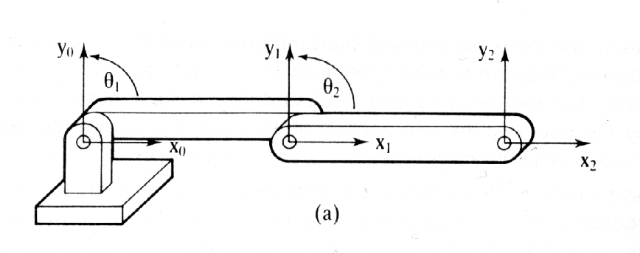
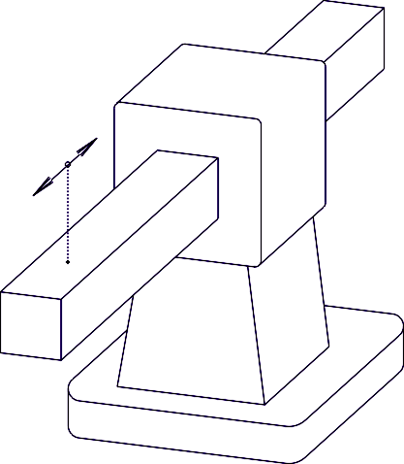
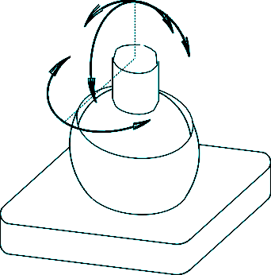
Other basic joints
Revolute Joint
1 DOF ( Variable - )
Prismatic Joint
1 DOF (linear) (Variables - d)
Spherical Joint
3 DOF ( Variables - ₁, ₂, ₃)
Concepts:
Prismatic joint
Spherical joint

Slide 6
We are interested in two kinematics topics
Forward Kinematics (angles to position)
What you are given: The length of each link
The angle of each joint
What you can find: The position of any point
(i.e. it’s (x, y, z) coordinates
Inverse Kinematics (position to angles)
What you are given: The length of each link
The position of some point on the robot
What you can find: The angles of each joint needed to obtain
that position
Concepts:
Forward Kinematics
Inverse Kinematics

Slide 7
Math Review

Slide 8
Review of Vectors and Matrices

Slide 12
Dot Product and Unit Vector
Dot Product:
Geometric Representation:
Matrix Representation:
Unit Vector
Vector in the direction of a chosen vector but whose magnitude is 1.
Concepts:
Dot Product
Unit Vector

Slide 13
More on Dot Product

Slide 15
Review of Matrices

Slide 17
Quick Matrix Review
Matrix Multiplication:
An (m x n) matrix A and an (n x p) matrix B, can be multiplied since the number of columns of A is equal to the number of rows of B.
Non-Commutative Multiplication
AB is NOT equal to BA
Matrix Addition:
Concepts:
Matrix Multiplication
Matrix Addition

Slide 21
Inversion of Matrices

Slide 24
Translation

Slide 25
Basic Transformations
Moving Between Coordinate Frames
Translation Along the X-Axis
Concepts:
Translation along the X axis
Y
O
(V^{N},V^{O})
V^{XY}
V^{NO}
V^{O}
P
N
X
V^{N}
P_{x}
P_{x} = distance between the XY and NO coordinate planes
Notation:

Slide 26
Writing in terms of
Y
O
V^{XY}
V^{NO}
V^{O}
P

X
V^{N}
N

Slide 27
O
Translation along the X-Axis and Y-Axis
Y
V^{NO}
V^{O}
V^{XY}
N
V^{N}
P^{XY}
X
Concepts:
Translation along the X axis and Y axis

Slide 28
Using Basis Vectors
Basis vectors are unit vectors that point along a coordinate axis
O
Unit vector along the N-Axis
Unit vector along the O-Axis
V^{NO}
V^{O}
Magnitude of the V^{NO} vector
V^{N}
N
Concepts:
Using planar trigonometry to calculate the vector from projections

Slide 29
Rotation

Slide 30
Y
Rotation (around the Z-Axis)
We rotate around Z and we have two frames of reference for the same vector
Z
X
Y
O
V^{O}
V
N
V^{Y}
V^{N}

X
V^{X}
 = Angle of rotation between the XY and NO coordinate axis
Concepts:
Rotation around Z-Axis

Slide 31
Y
Unit vector along X-Axis
O
Can be considered with respect to
the XY coordinates or NO coordinates
V
V^{O}
N
V^{Y}

V^{N}

V^{X}
X
(Substituting for V^{NO} using the N and O components of the vector)
Concepts:
Rotation around Z-Axis

Slide 32
Similarly….
So….
Written in Matrix Form
Rotation Matrix about the z-axis
Concepts:
Rotation around Z-Axis

Slide 33
Rotation together with translation

Slide 34
Y¹
O
(V^{N},V^{O})
Y⁰
V^{NO}
N
V^{XY}

P
X¹
Translation along P followed by rotation by θ
X⁰
(Note : P_{x}, P_{y} are relative to the original coordinate frame. Translation followed by rotation is different than rotation followed by translation.)
In other words, knowing the coordinates of a point (V^{N},V^{O}) in some coordinate
frame (NO) you can find the position of that point relative to your original
coordinate frame (X⁰Y⁰).
Concepts:
Rotation around Z-Axis

Slide 35
HOMOGENEOUS REPRESENTATION for robot kinematics
One of important representations in robotics
Putting it all into a Matrix

Slide 36
HOMOGENEOUS REPRESENTATION
Putting it all into a Matrix
What we found by doing a translation and a rotation
Padding with 0’s and 1’s
Simplifying into a matrix form
Homogenous Matrix for a Translation in XY plane, followed by a Rotation around the z-axis
Concepts:
All transformations can be put into one Matrix Notation.

Slide 37
Rotation Matrices in 3D

Slide 41
How to represent a sequence of translations and rotations, a case common in robot arm design?

Slide 42
Homogeneous Matrices in 3D
H is a 4x4 matrix that can describe a translation, rotation, or both in one matrix
O
Y
N
P
X
A
Translation without rotation
Z
Y
O
N
X
Rotation part:
Could be rotation around z-axis, x-axis, y-axis or a combination of the three.
Z
Rotation without translation
A

Slide 43
Homogeneous Continued…. combining rotation and translation to one matrix
The (n,o,a) position of a point relative to the current coordinate frame you are in.
The rotation and translation part can be combined into a single homogeneous matrix IF and ONLY IF both are relative to the same coordinate frame.

Slide 44
Finding the Homogeneous Matrix
EXAMPLE.
J
Y
N
I
T
P
X
K
A
O
Z
Point relative to the
X-Y-Z frame
Point relative to the
I-J-K frame
Point relative to the
N-O-A frame
Different notation for the same thing

Slide 45
J
Y
I
N
T
X
P
K
A
O
Z
Substituting for

Slide 46
Product of the two matrices
Notice that H can also be written as:
H = (Translation relative to the XYZ frame) * (Rotation relative to the XYZ frame)
* (Translation relative to the IJK frame) * (Rotation relative to the IJK frame)

Slide 47
The Homogeneous Matrix is a concatenation of numerous translations and rotations
J
Y
I
N
T
X
P
K
A
O
Z
One more variation on finding H:
H = (Rotate so that the X-axis is aligned with T)
* ( Translate along the new t-axis by || T || (magnitude of T))
* ( Rotate so that the t-axis is aligned with P)
* ( Translate along the p-axis by || P || )
* ( Rotate so that the p-axis is aligned with the O-axis)
This method might seem a bit confusing, but it’s actually an easier way to solve our problem given the information we have.
Here is an example…

Slide 48
Frames of Reference
and transformations:
EULER ANGLES

Slide 49
Rotation Matrices in 3D - towards homogenous representation
Rotation around the Z-Axis
Rotation around the Y-Axis
Rotation around the X-Axis

Slide 52
The Rotation Matrix (called also Direction Cosine Matrix)

